Slide 1
Digital Image Processing:
Introduction

Slide 2
Contents
This lecture will cover:
- What is a digital image?
- What is digital image processing?
- History of digital image processing
- State of the art examples of digital image processing
- Key stages in digital image processing

Slide 3
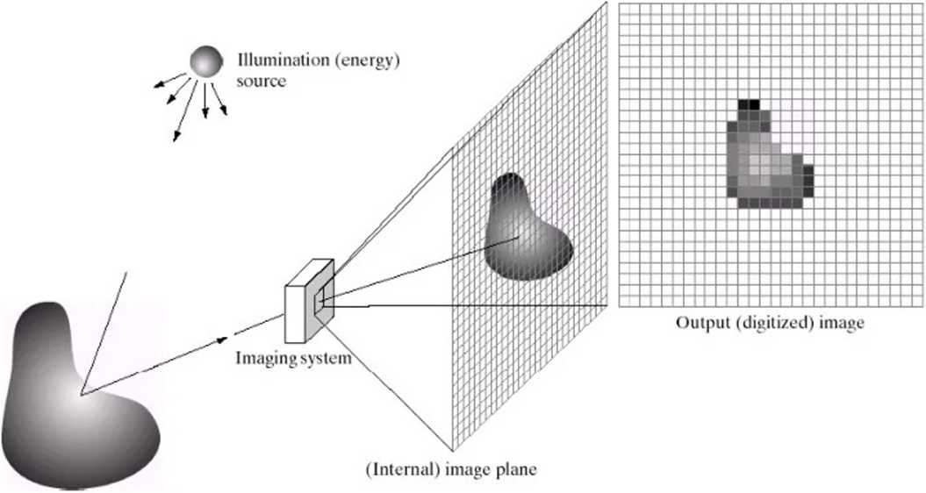
What is a Digital Image?
A digital image is a representation of a two-dimensional image as a finite set of digital values, called picture elements or pixels

Slide 4
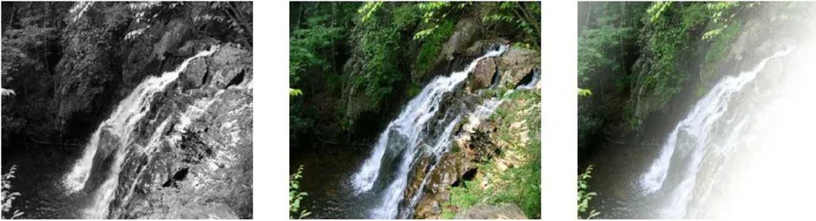
What is a Digital Image? (cont...)
Common image formats include:
- 1 sample per point (B&W or Grayscale)
- 3 samples per point (Red, Green, and Blue)
- 4 samples per point (Red, Green, Blue, and “Alpha”, a.k.a. Opacity(transperancy))
For most of this course we will focus on grey-scale
images

Slide 5
What is Digital Image Processing?
Digital image processing focuses on two major tasks
Improvement of pictorial information for human interpretation
Processing of image data for storage, transmission and representation for autonomous machine perception

Slide 6
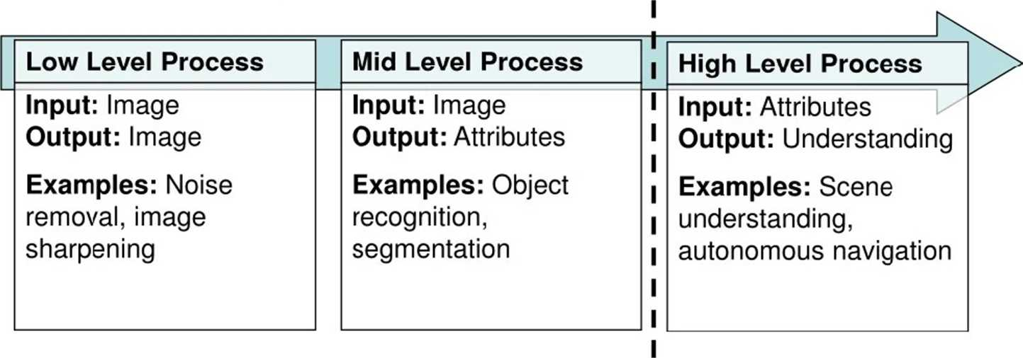
What is DIP? (cont...)
The continuum from image processing to computer vision can be broken up into low-, mid- and high-level processes
In this course we will stop here

Slide 7
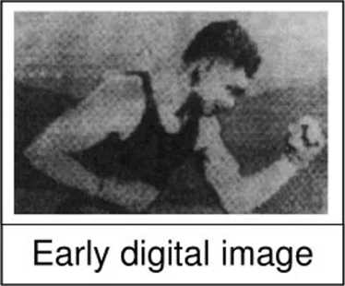
History of Digital Image Processing
Early 1920s: One of the first applications of
digital imaging was in the newspaper industry
- The Bartlane cable picture transmission service
- Images were transferred by submarine cable between London and New York
- Pictures were coded for cable transfer and reconstructed at the receiving end on a telegraph printer

Slide 8
History of DIP (cont...)
1980s - Today: The use of digital image processing techniques has exploded and they are now used for all kinds of tasks in all kinds of areas
- Image enhancement/restoration
- Artistic effects
- Medical visualisation
- Industrial inspection
- Law enforcement
- Human computer interfaces

Slide 9
History of DIP (cont...)
1980s - Today: The use of digital image processing techniques has exploded and they are now used for all kinds of tasks in all kinds of areas
- Image enhancement/restoration
- Artistic effects
- Medical visualisation
- Industrial inspection
- Law enforcement
- Human computer interfaces

Slide 10
History of DIP (cont...)
1980s - Today: The use of digital image processing techniques has exploded and they are now used for all kinds of tasks in all kinds of areas
- Image enhancement/restoration
- Artistic effects
- Medical visualisation
- Industrial inspection
- Law enforcement
- Human computer interfaces

Slide 11
History of DIP (cont...)
1980s - Today: The use of digital image processing techniques has exploded and they are now used for all kinds of tasks in all kinds of areas
- Image enhancement/restoration
- Artistic effects
- Medical visualisation
- Industrial inspection
- Law enforcement
- Human computer interfaces

Slide 12
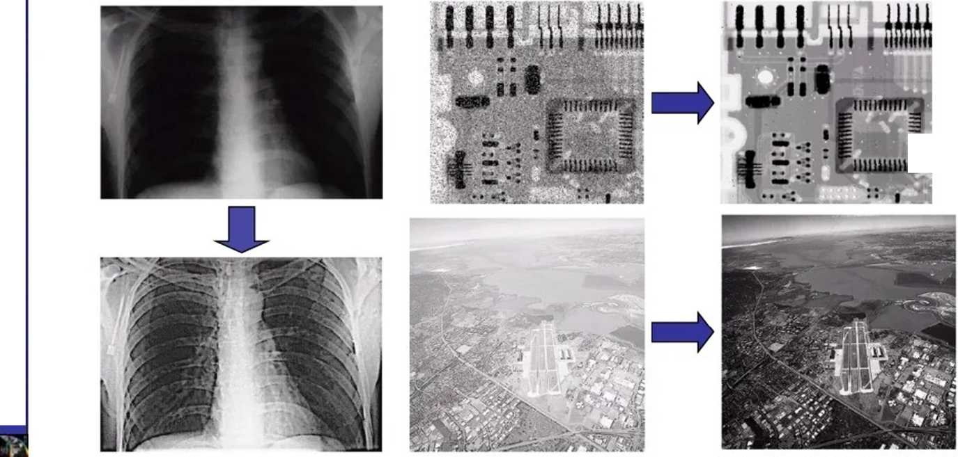

Examples: Image Enhancement
One of the most common uses of DIP techniques: improve quality, remove noise etc

Slide 13
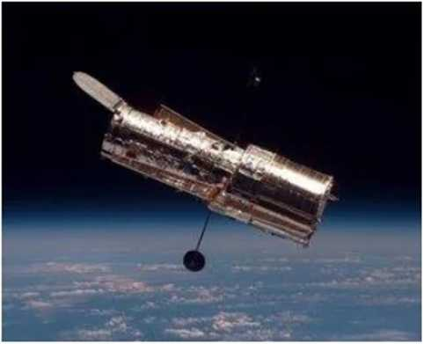
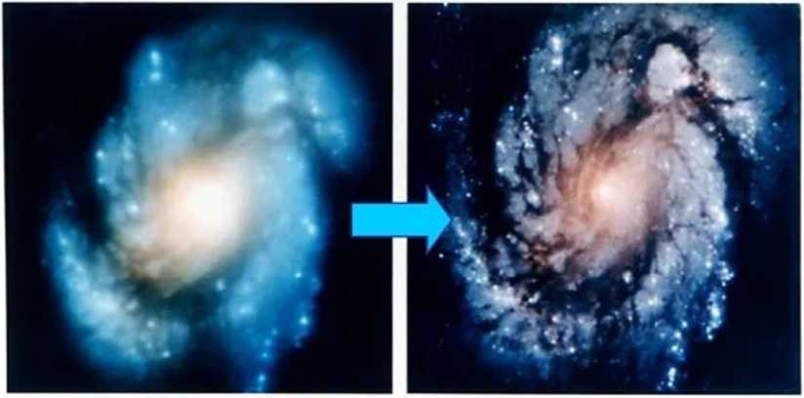
Examples: The Hubble Telescope
Launched in 1990 the Hubble telescope can take images of very distant objects
However, an incorrect mirror made many of Hubble’s
images useless
Image processing techniques were used to fix this
i Pi.vvT.sty Camera 1

Slide 14
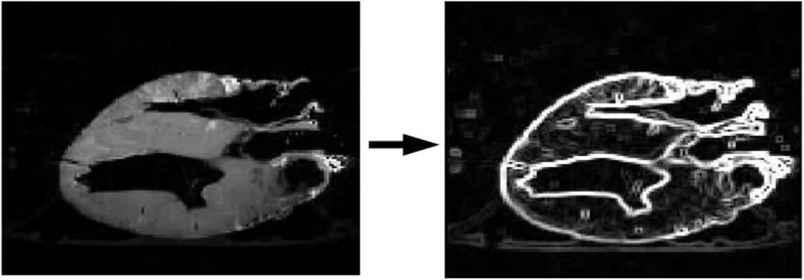
Examples: Medicine
Take slice from MRI scan of canine heart, and find boundaries between types of tissue
- Image with gray levels representing tissue density
- Use a suitable filter to highlight edges
Original MRI Image of a Dog Heart _{Edge} Detection Image

Slide 15
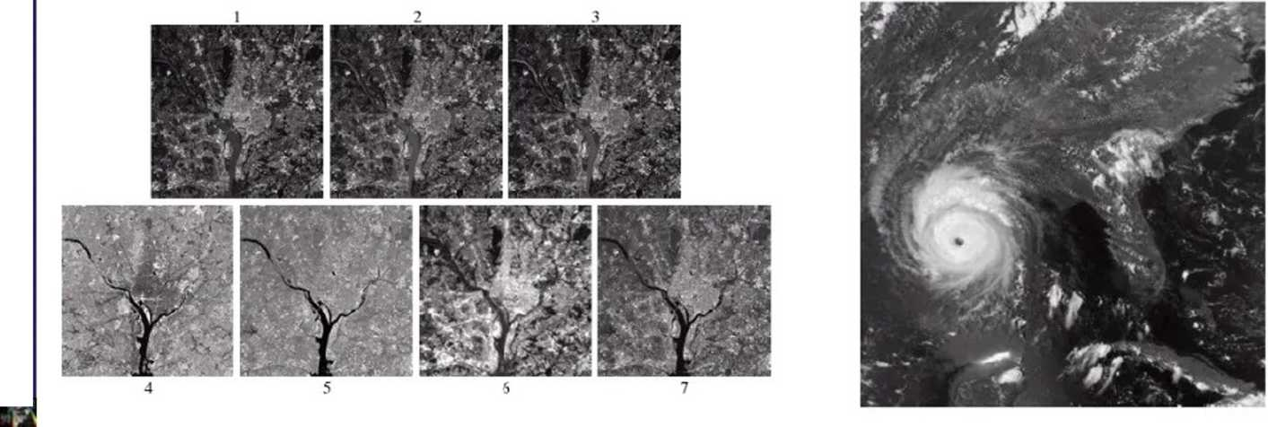
Examples: GIS
Geographic Information Systems
- Digital image processing techniques are used extensively to manipulate satellite imagery
-Terrain classification
- Meteorology

Slide 16
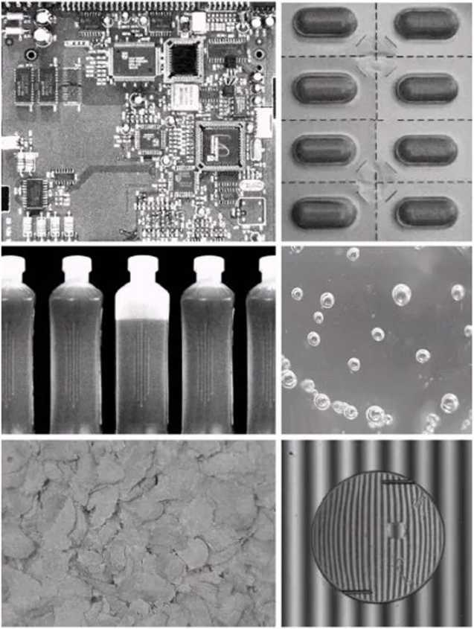
Examples: Industrial Inspection
Human operators are expensive, slow and unreliable
Make machines do the job instead
Industrial vision systems are used in all kinds of industries
Can we trust them?

Slide 17
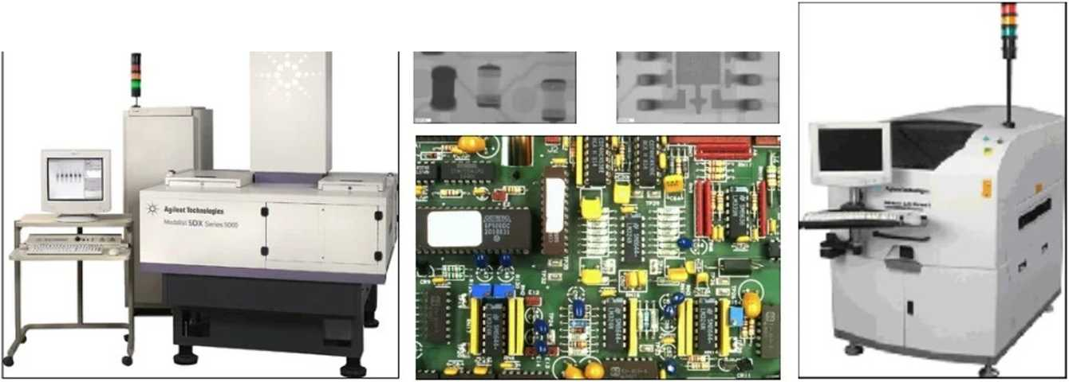
°* Examples: PCB Inspection
Printed Circuit Board (PCB) inspection
- Machine inspection is used to determine that all components are present and that all solder joints are acceptable
- Both conventional imaging and x-ray imaging

Slide 18
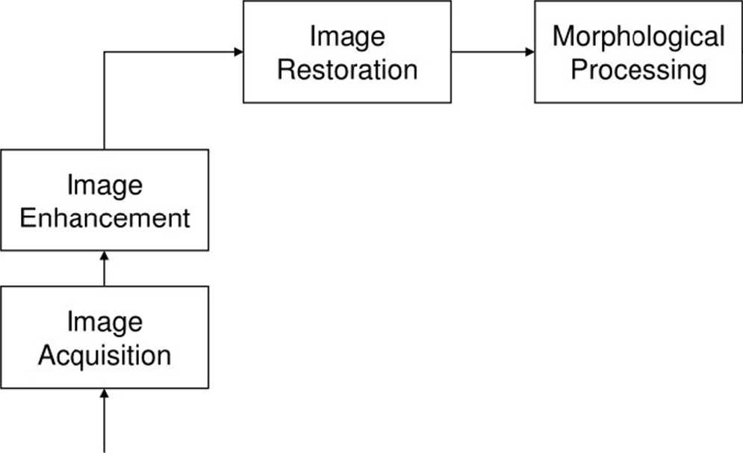
Key Stages in Digital Image Processing
Segmentation
Object
Recognition
Problem Domain
Representation & Description
[ Colour Image i
j Processing |
, Image i
| Compression [

Slide 19

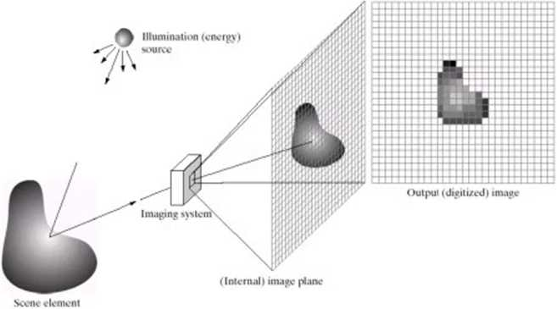
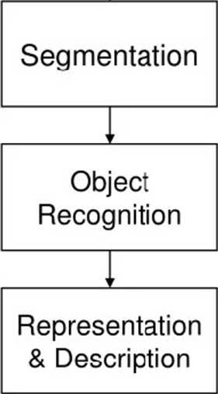
Key Stages in Digital Image Processing:
Image Aquisition
Image
Enhancement
Image
Acquisition
Problem Domain
[ Colour Image i
j Processing |
, Image i
| Compression [

Slide 20

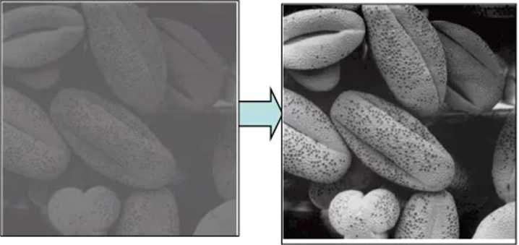
Key Stages in Digital Image Processing:
Image Enhancement
Image
Enhancement
Segmentation
Image
Acquisition
Object
Recognition
Problem Domain
Representation & Description
r
[ Colour Image i
j Processing |
, Image i
| Compression [

Slide 21

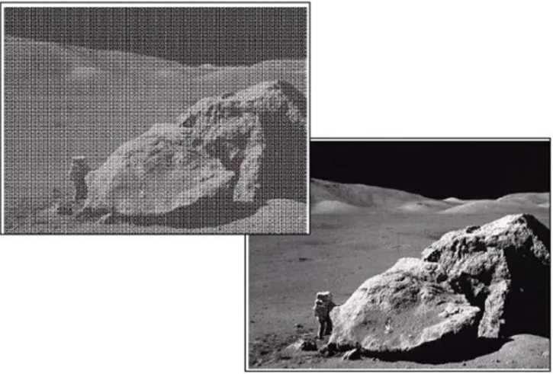
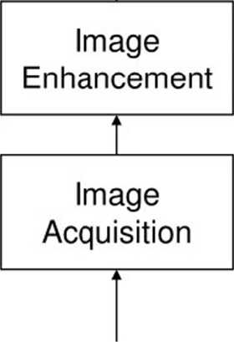
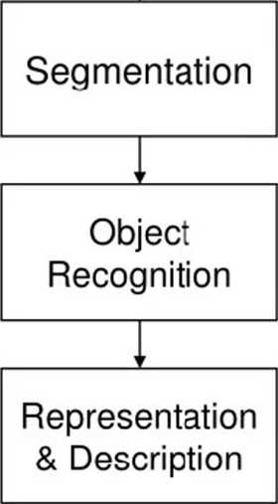
Key Stages in Digital Image Processing:
Image Restoration
Problem Domain
r
[ Colour Image i
, Image i | Compression [
i i
Processing |

Slide 22
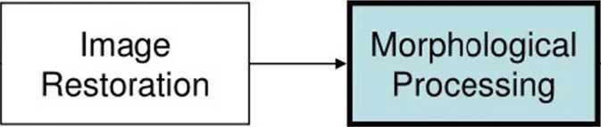
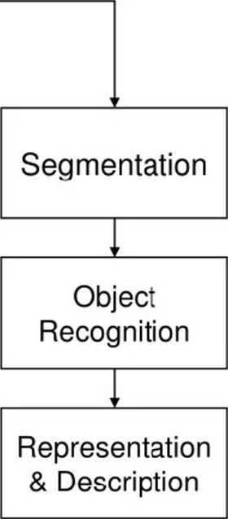
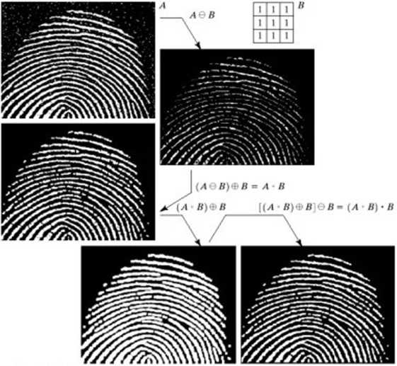
Key Stages in Digital Image Processing:
Morphological Processing
Image
Enhancement
Image
Acquisition
Problem Domain
i
i
i
i
i | i
Colour Image i , Image i
Processing | j Compression [

Slide 23
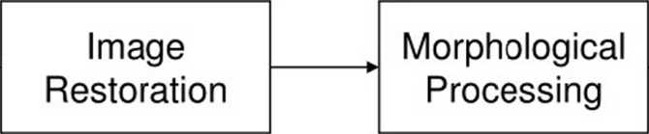
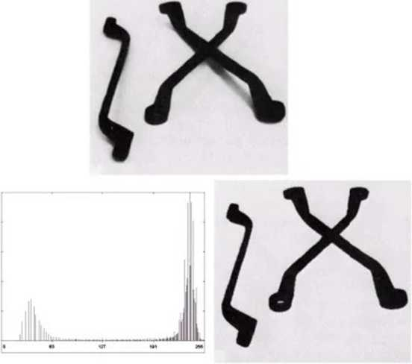
Key Stages in Digital Image Processing:
Segmentation
Image
Enhancement
Segmentation
Image
Acquisition
Object
Recognition
Problem Domain
Representation & Description
\ Colour Image i j Processing |
, Image i | Compression [
' >

Slide 24

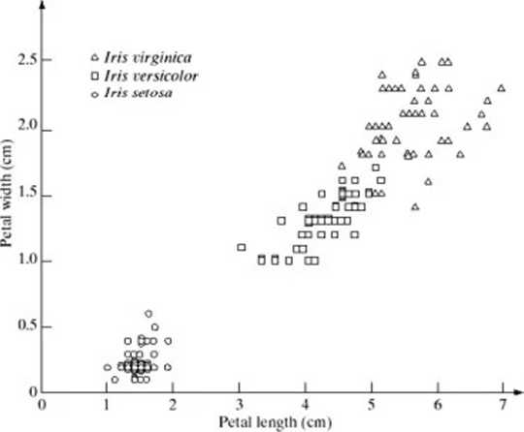
Key Stages in Digital Image Processing:
Object Recognition
Xj
Image
Enhancement
Segmentation
Image
Acquisition
Object
Recognition
Problem Domain
Representation & Description
r
\ Colour Image i
| Processing |
, Image i
| Compression [

Slide 25
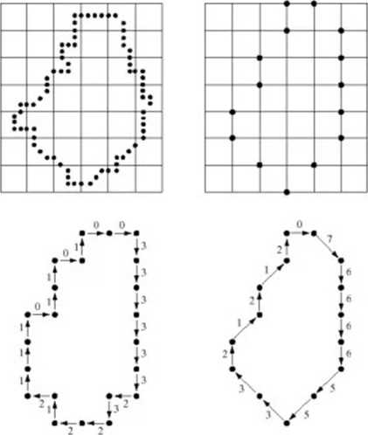
Key Stages in Digital Image Processing:
Representation & Description
Image
Restoration
Morphological
Processing
*•
Image
Enhancement
Segmentation
Image
Acquisition
Object
Recognition
1
Representation & Description
Problem Domain
i
i
i
i
Colour Image i , Image i
Processing | j Compression [

Slide 26

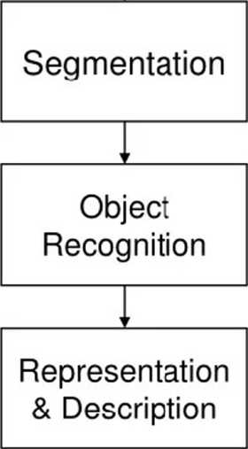
Key Stages in Digital Image Processing:
Image Compression
•BwinZip (F valuation Version) |  | impres<irioopi.7lp |  | EBB
Fie Actors View Jobs Options © m & New Open Favorites Name lype |  | Help Add Extract notified | 0 Encrypt size | /lew O Kate pack, «■»
^]jal3ctt)oerd.pf»3 ; | PNG Image | 21/09/200509:22 | 12,542 | 1% | 12,41
5)error.prg | PNG Image | 07/04/2005 10:56 | 282 | 13% | 2‘
info.png | PNG Image | 07/04/2005 10:35 | 293 | 12% | 2!
^jmxro.p-g | PNG Image | 01/04/2005 13:16 | 5,153 | 0% | 5,1!
•Ostart.pnj | PNG Image | 07/04/2005 10:36 | 256 | 14% | Z.
5]stop.pr«j | PNG Image | 07/04/2005 10:36 | 255 | 15% | 2:
vaM-rfiimllO.png | PNG Image | 30/03/2005 13:29 | 2,580 | 13% | 2,2*
war ring png | PNG Image | 07/04/2005 10:35 | 296 | 12% | 2i
"^impresario.css | CascadhgS... | 22/04/2005 16:06 | 4,780 | 76% | 1,H
•) index. hfcrl | HTM Fie | 21/09/2005 08:16 | 5,233 | 68% | 1,6!
•Jmacroacranced.... | HIM Fie | 21/09/200509:08 | 3,242 | 64% | 1,1!
•JmacrobtKHjoar... | HTM Fie | 21/09/200513:34 | 11,029 | 71% | 3,21
<1 macrocreate.html | HTM Fie | 21/09/200506:16 | 5,664 | 70% | 1,71
fjrracrogj.htrrl | HTM Fie | 21/09/2005 15:45 | 4,912 | 63% | 1,8.
*}macr«rformatio... | HTM Fie | 21/09/2005 08:16 | 4,537 | 69% | 1,41
■Ktmirrraroi + Kfml < | MTM PI* |  | 7 >CA |  | >
Selected 0 ties, 0 bytes |  | Total 1323 files, 348,804KB |  |  | QO
Image
Enhancement
Image
Acquisition
Problem Domain
[ Colour Image i | Image i
| Processing | ₍ Compression i

Slide 27

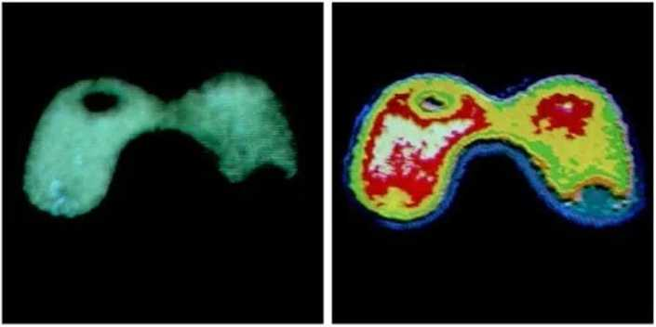
Key Stages in Digital Image Processing:
Colour Image Processing
Image
Enhancement
Segmentation
Image
Acquisition
Object
Recognition
Problem Domain
Representation & Description
r
I Colour Image i
l Processing i
, Image i
| Compression [

